Slide 1

Briefing for Headteachers The UCL ECTE programme The UCL NPQ options
Realising everyone’s potential

Slide 2

Realising everyone’s potential
Briefing agenda:
REP’s Golden Thread of CPD
The ECT programme
Your Appropriate Body (AB) choices
National Professional Qualifications

Slide 3
Our golden thread of professional development
ITT
ECF
NPQs
School Leadership
Aspiring Heads
New Headteachers
Headship support
"Teach in Redbridge"
UCL programme
UCL options
Primary subjects leader networks, SENCO support, Hemisphere
"Heads Up"
Buddy induction
SPG groups

Slide 4

The ECF programme
Professional bodies involved
Separated responsibilities
Choices for schools
REP as a Delivery partner for UCL
Current support for 31 schools, 94 ECTs and 76 mentors

Slide 5

Roles and Responsibility
ECF
Lead Provider
Delivery Partner
Appropriate Body
Department of Education
UCL
REP
Harris
Registers ECTs and Mentors for the ECF
Manage the DfE portal
Funding comes from DfE
Wrote the programme
Design the materials
Facilitators deliver the programme
Monitor attendance and engagement of programme which is reported to UCL and the DfE
Manage ECT Manager
‘Signs off’ ECT
Supports schools and ECT if there is an issue
Notes:
You might want to discuss the differences- please feel free to use anything below.
Answer any questions ECTs or Mentors have (you can refer to the programme handbook for this) Ensure everyone understands the following:
Who their Lead Provider, Delivery Partner and Appropriate Body and Induction Tutor and Mentor are, and the roles and responsibilities of each of them
That it is a statutory requirement that all ECTs engage fully in a structured induction programme based on the Early Career Framework (a framework that outlines what all Early Career teachers should know and be able to do).
As a school you have a choice. If you elect to do the Full Induction Programme with UCL as your lead provider. This means they will follow UCL’s programme of professional development for ECTs over the next two years (longer, if they are following the programme on a part-time basis). This will involve completing 9 modules of professional learning over 2 years. As part of each module, they will attend sessions held by their delivery partner, complete self-study and attend weekly mentor sessions. The programme is not assessed, but they will need to complete all the activities and submit a module completion form at the end of every module. They have received a 10 % reduction on their timetable in their first year and a 5% reduction in their second year, so they have time to complete these professional learning activities The best way to understand the whole programme is by looking at the curriculum map on the web page or UCL Extend (and copied on the next slide.)
The difference between their lead provider and appropriate body: their lead provider is UCL. This means they will follow UCL’s programme of professional development for ECTs over the next two years. Whilst they must engage in all the activities on the programme (and this is monitored) , the programme is not assessed . Their appropriate body is (are you talking about this?) they are responsible for making sure they get their statutory entitlement and make the final decision as to whether the ECT has satisfactorily met the Teacher Standards based on the headteacher’s judgement. Termly progress reports which assess ECTs against the teaching standards are submitted to the appropriate body (not UCL).

Slide 6
UCL’s ECT programme
ECT terms explained – ECTs, mentors, Induction Tutors (handout)
REP is a Delivery partner, not the Appropriate Body
REP’s offer is open to all
Primary, secondary and special schools
Maintained, Independent and Academy schools
Offer for schools in Waltham Forest
Redbridge-based staff lead and manage the REP programme
REP programme director – Bob Drew OBE
REP administrator – Bijal Pithia

Slide 7
Delivering the programme
High quality, local facilitators
Local clusters - Primary, Secondary, Redbridge, Waltham Forest
Blend of training – online/in-person
Mentor training
Facilitator training and quality assurance
UCL’s research engaged programme design
High quality professional development materials for facilitators

Slide 8
Key features UCL ECF programme
Knowledge and research informed
Drawn from expert theory and current practice
Ofsted Outstanding
Designed to be experienced as a spiral curriculum
Situated in the context of the ECF
Reflective and inquiry-focused
Flexible

Slide 9
Year One
M1
M2
M3
M4
M5
M6
Fulfilling Professional Responsibil-ities
Enabling Pupil Learning
Engaging Pupils in Learning
Developing Quality Pedagogy
Meeting Pupils’ Needs
Making Productive Use of Assessment
Year Two
M7
M8
M9a
M9b
M9c
M10
Exploratory
Inquiry focusing on
Enabling Pupil Learning
Exploratory
Inquiry focusing on
Engaging Pupils in Learning
School Visits focusing on
Fulfilling Professional
Responsibil-ities
Evaluative Inquiry focusing on Developing Quality Pedagogy or Meeting Pupils’ Needs or Making Productive use of Assessment
Notes:
NEW
We have arranged Year 1 into 6 modules, each covering a half-term
SIMILAR
Year 2, as now, has 4 modules. We are breaking the ‘long’ module 9 into 3 parts a-c, to help with ECTs who might otherwise get lost

Slide 10
The Programme for ECTs (Year 1)
23 Independent Study Sessions
39 mentor meetings
6 Facilitated Learning Sessions
6 Local Learning Communities
Notes:
SAME
The elements of the programme for ECTs in Year 1 are structured in the same way to the current ECF programme

Slide 11

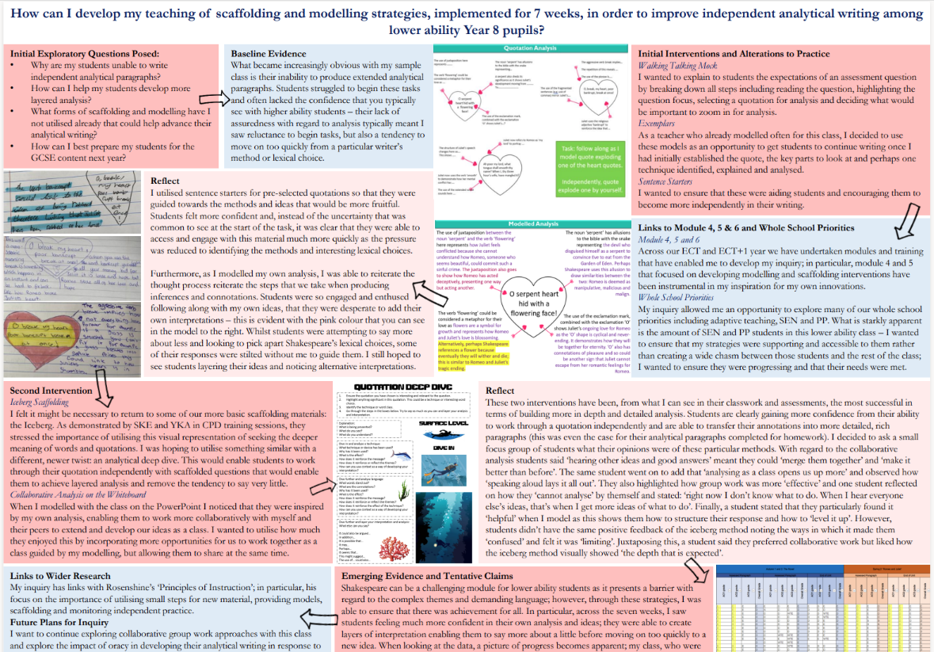


Year 2
4 modules Educative mentoring 5 independent study hours Practitioner inquiry 4 facilitated learning sessions School visits in the summer
Notes:
SAME
The elements of the programme for ECTs in Year 2 are structured in the same way to the current ECF programme.
The main features – practitioner inquiry and the School Visit are retained

Slide 12

Changes for 2025
For the Year One cohorts only
Revisions to Year Two come in September 2026
New name – the ECTE programme
Changes to the Module order and content
Mentor training
Funding bias

Slide 13

Why choose the REP provision?
High quality training – UCL pedigree
UCL Quality Assurance
Reviews by ECTs and Mentors
Quality of Facilitators
Adapted to meet the needs of each local group
Local support available by trusted colleagues
Accountable to REP

Slide 14
Quotes from teachers
The program has added to my knowledge, skills and understanding through learning what a ‘good’ teacher must accomplish and how to do this. This was particularly useful during my first year ECT sessions where many in-person meetings took place with high level teachers giving instruction on how to deal with SEND children, parents, workload and effective practice.
- Year 2 ECT
I found the ECT training program very insightful and beneficial. My growth as a teacher has significantly improved due to the self-directed study materials on the program covering fundamental topics. One area where the program has particularly helped me is in standard 6, in making productive use of assessment. Overall, the program's theoretical components have greatly developed my practical ethics in the classroom.
- Year 1 ECT
The UCL programme has high expectations and engages teachers with best practice. I love the engagement with research that underpins the training, this sets a high bar for professionalism. The UCL programme has supported all the school’s ECTs for 3 years, I am really confident this is a superb programme.
- ECT tutor

Slide 15
Most recent feedback from Module Evaluations
ECTs
100% gave highly positive evaluation of their ability to develop high quality practices
96% gave positive evaluations on the programme
84% gave highly positive feedback on the self-directed materials
91% gave a positive evaluation of the Facilitated training sessions
Mentors
91% gave a positive evaluation of the quality of the meetings
96% were positive about the ECT programme
77% gave a highly positive evaluation of the programme’s ability to support ECTs to develop high quality practices and to apply their learning to their teaching

Slide 16
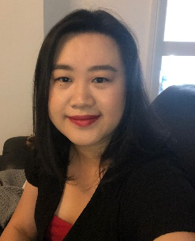
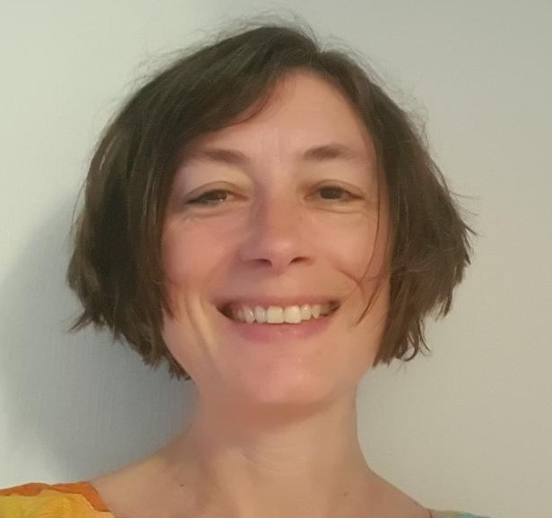
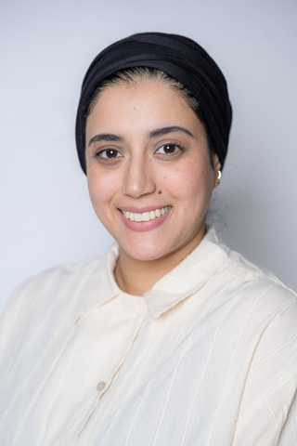
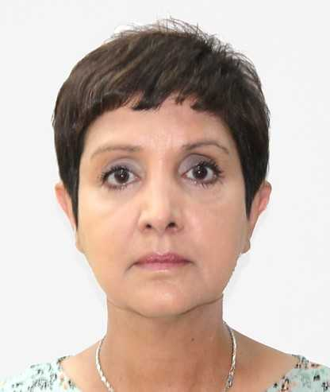
Our Facilitators
Seet Ying Fan
Was previously the ECT lead for NELTSH
Assistant Head at Gearies Primary
Experienced Facilitator
Previously the Teaching School Manager for the Gants Hill Alliance Teaching School
Kate Thorpe
International Consultant
UCL Researcher
Experienced Facilitator
Published author on curriculum content
Delivered CPD in several countries
Kay Bousetta
Deputy Head at Riverley Primary
Experienced Facilitator
Supports ECT programmes within the Griffin School Trust
Kiran Gill
Experienced Facilitator with numerous DPs
Education Consultant
Also leads our NPQ programme delivery
Previous senior roles in secondary schools

Slide 17
Enrolling process
Step One – Induction Tutor to register new ECTs and Mentors on “Manage training for Early Career Teachers” DfE website
Step Two - Appoint your Appropriate Body and register all ECTs with the AB on ECT Manager
Step Three - ECT Manager Portal opens in early July 2025
Step Four – contact REP as soon as possible to inform us of your intent – we can then onboard your ECTs and Mentors to the programme, sharing dates and venues for all coming meetings (please use our “Expression of Intent” document)

Slide 18

Existing ECTs
ECTs and Mentors currently registered on our programme will be automatically rolled over by UCL to next year
Induction tutors though must confirm their school’s intentions with the DfE, even if they have no new ECTs or mentors
There are walk-through videos from the DfE on how to manage all training – we will send you the powerpoint that contains all options available

Slide 19

Flexibility – our support for non-standard ECTs
Bespoke enrollment to meet different starting points, previous experience and engagement with action plans
Personal design of programme

Slide 20

Questions on the ECTE programme

Slide 21
Your Appropriate Body Options

Slide 22
The Appropriate Body
Functions and connection to the ECT programme
Local options
Responsiveness to our local needs
Activity on ECT Manager
Weekly log of mentor meetings
Lesson observations
Termly evaluations
Concerns over an ECT’s progess – support available

Slide 23
Questions about choosing an AB

Slide 24

The UCL National Professional Qualifications

Slide 25
The UCL NPQs
DfE design of national programmes
Quality Assurance
Quality of UCL materials – gold standard
Leadership programmes – Headship, SNECO, Leading Learning , Leading Primary Mathematics, Leading Teaching, Senior Leadership
Specialist programmes
Our current NPQ SENCO course
Creating a viable cohort
The benefits of studying for an NPQ
Availability of scholarships
Local delivery

Slide 26

Questions about NPQs

Slide 27
Contacts and queries
Contact - Bob Drew: ecfdirect@repmail.co.uk
0774 363 6218
REP administrator – Bijal Pithia: ecfadmin@repmail.co.uk
0208 550 1803

