Slide 1

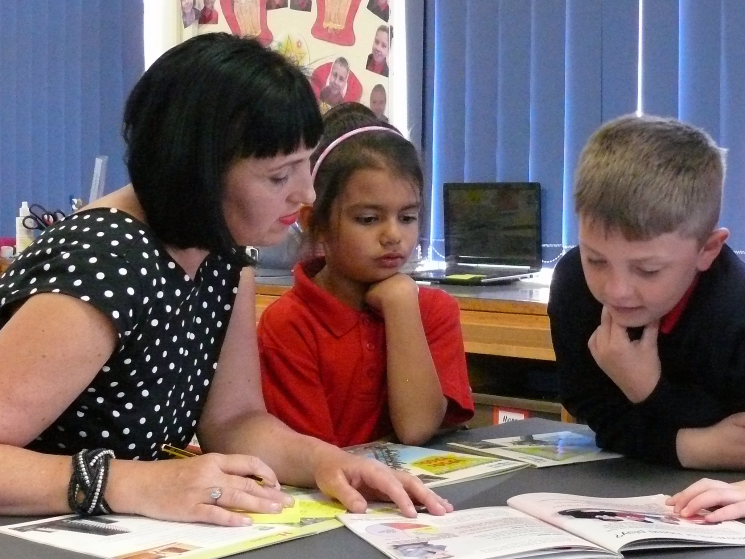
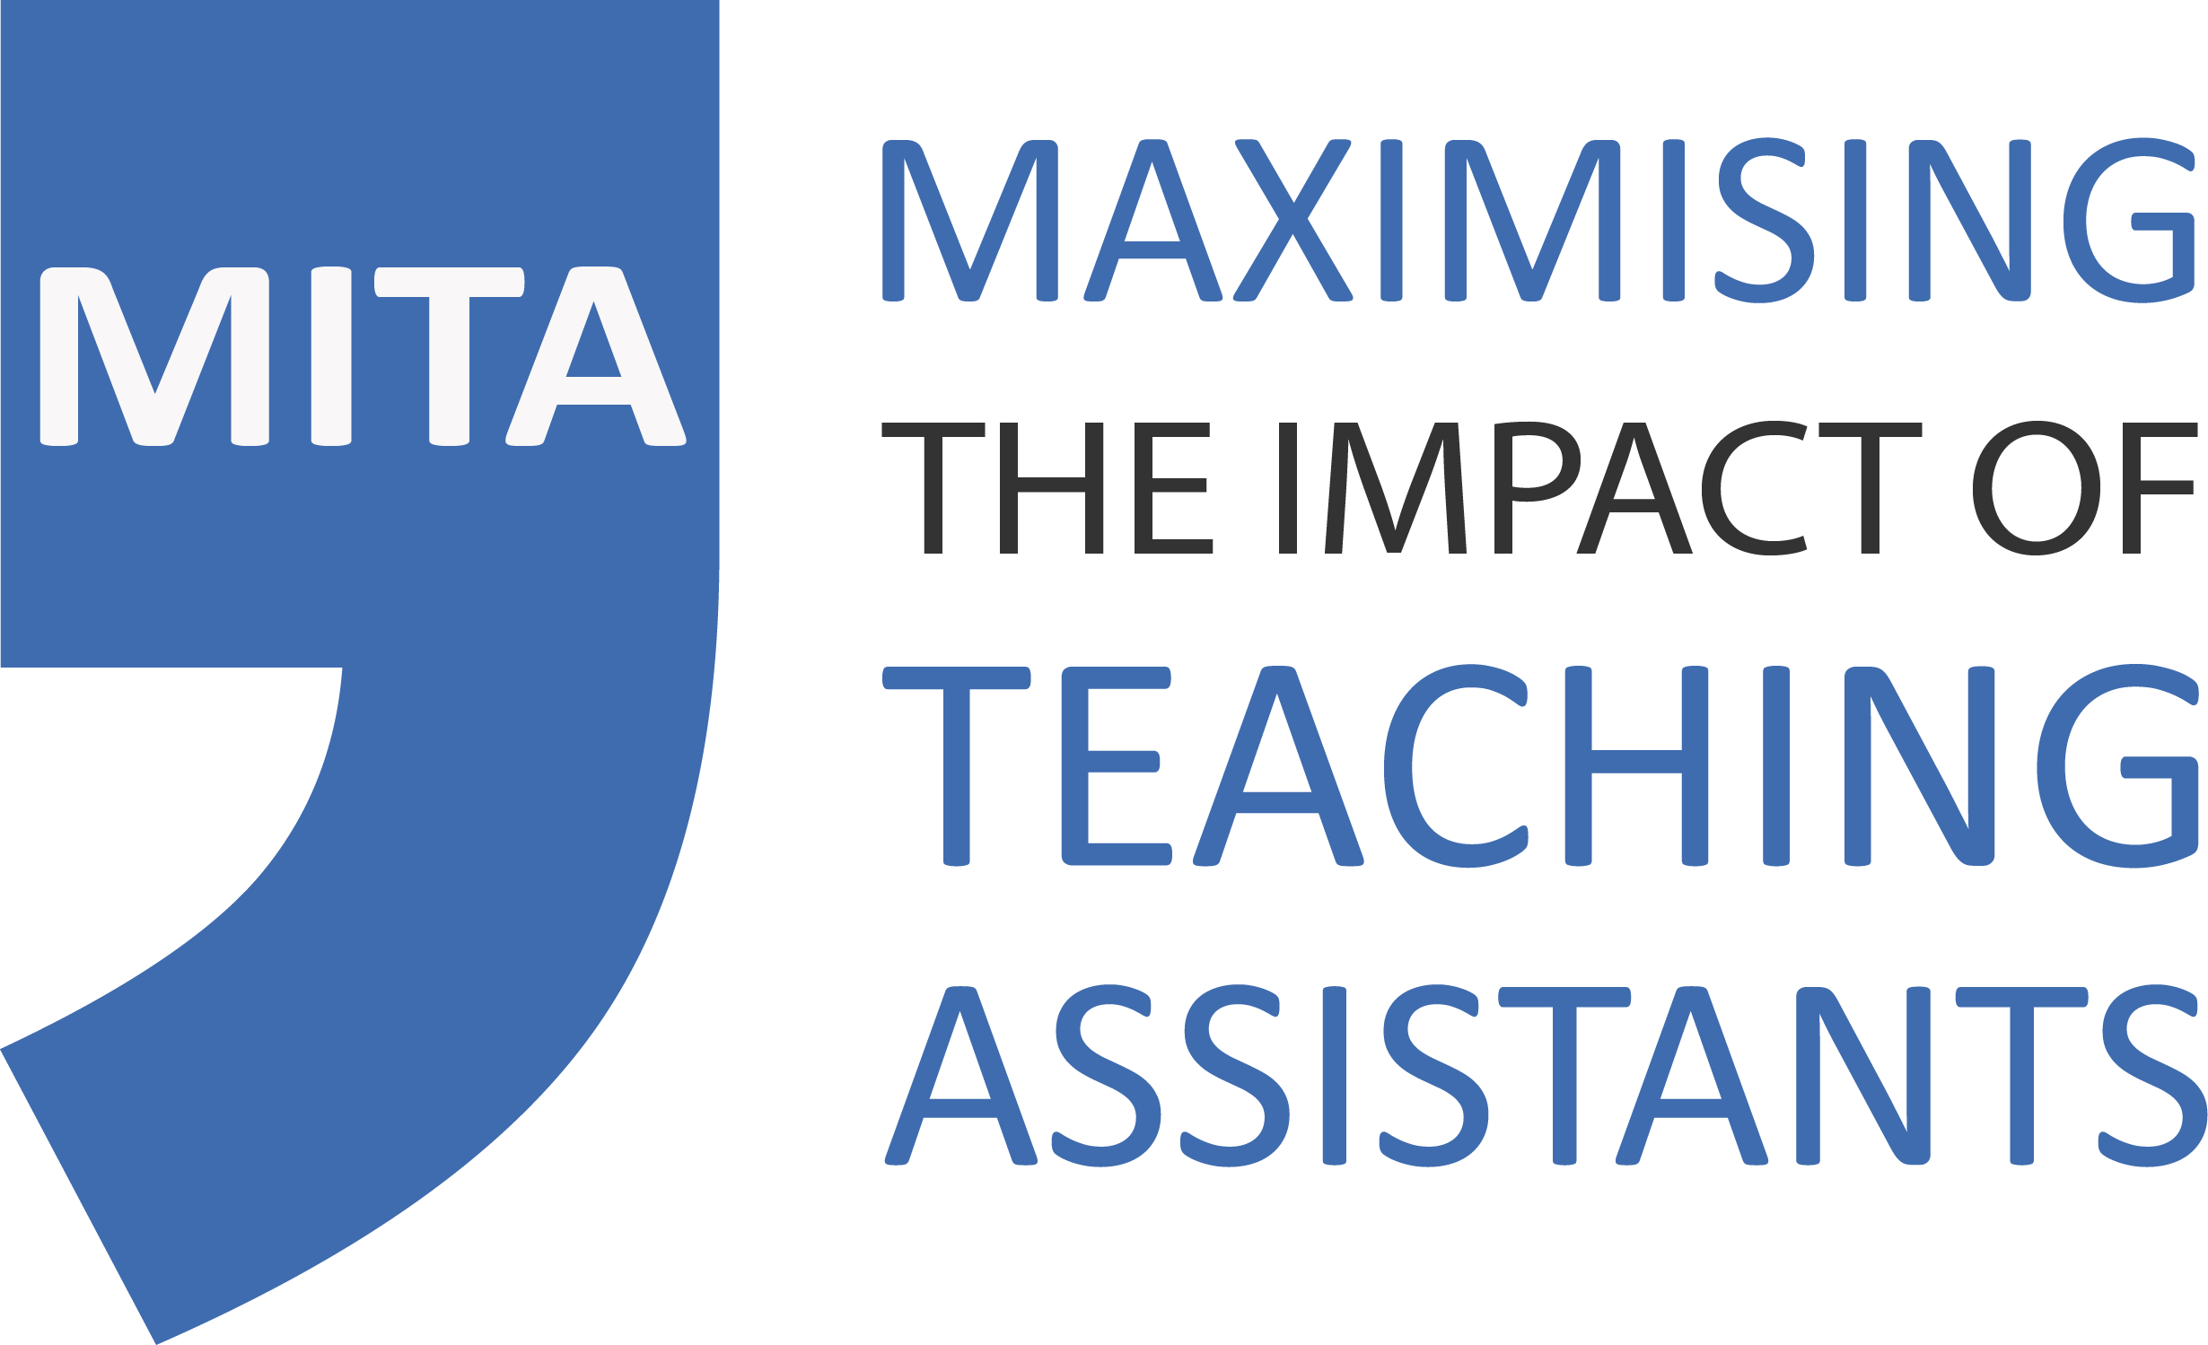


Maximising the Impact of Teaching Assistants
MITA Course Spring 2026 Redbridge Education Partnership
Sally Franklin – EdSEND, MITA, Research Box
Notes:
09.30
T
Welcome, intros

Slide 2
The big picture
Secondary population rising; SEND rising (proportionately)
Additional SEND provision (-14%), special school and AP capacity in decline (-11% vs. pop. +22% since 2004)
Pace of opening new specialist settings slow (50% by 2025)
Exclusions, off-rolling and ‘hostile’ admissions add to pressure on specialist settings
Specialist provision for secondary-aged pupils prioritised
Mainstream schools required to be more inclusive

Slide 3
The rise of TAs…
~400,000 TAs in English schools
Trebled since 2000
Largest Pupil Premium investment
More than roads, social housing
~£5bn to employ
What an opportunity!
More TAs than teachers in primary

Slide 4
What the research tell us
Good evidence that pupils make progress in literacy and numeracy as a result of structured interventions delivered by TAs (Sharples, 2016; Slavin, 2016)
The situation is different in relation to pupils who receive classroom based support (Webster et al., 2012)

Slide 5
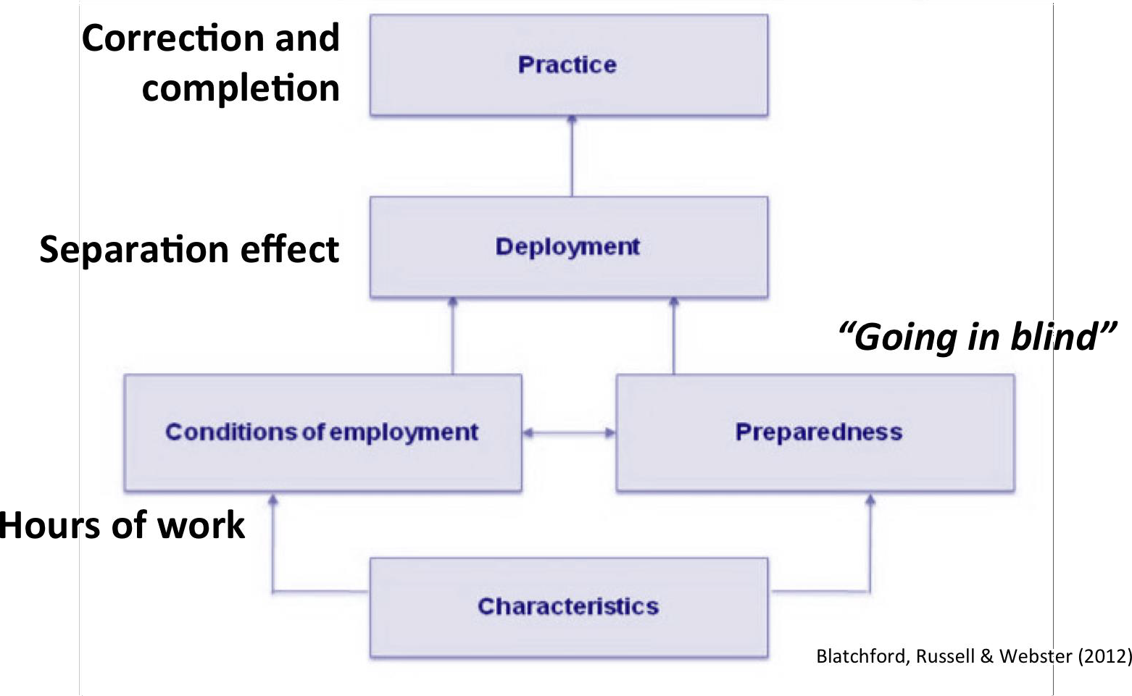
Understanding the evidence

Slide 6
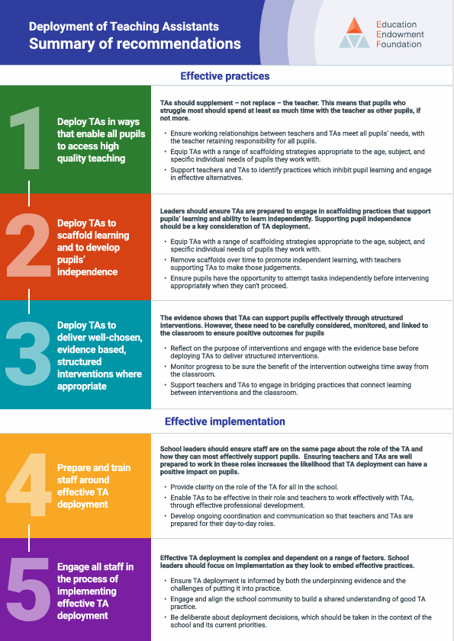
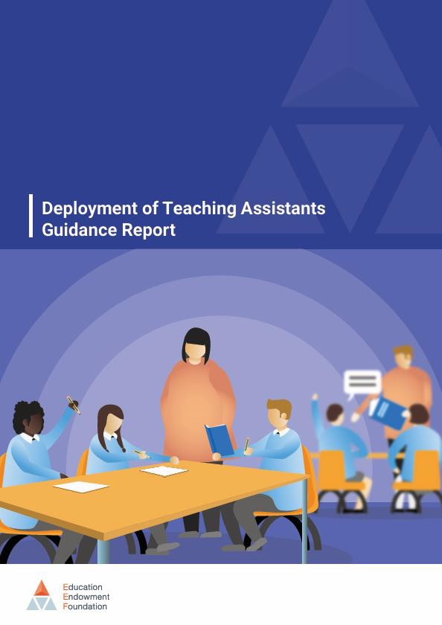
Practical, actional recommendations

Slide 7
Spring project: Commitment
Leadership strategy training:
MITA 1 & 2:
12th February 2026 9:30-3pm (HT and one other)
Research and Evidence in Context
Recommendations in practice
MITA 3:
24th March 2026 1-4pm (HT and one other)
Implementation planning
Developing Independence: (TAs one of five days)
Week beginning 16th March 9.30 – 3pm (online)
Developing Independence (Teaching staff):
13th April 1-2:30pm (online and recorded for schools unable to attend)

Slide 8
Thank you!
www.maximisingtas.co.uk
Sally Franklin
sally@ed-send.co.uk
Notes:
14.55
T

