Slide 1

Welcome to the REP PSHE Education CPD 2025-2026
Session 1 16th October 2025
Sinéad Culora

Slide 2
- Who we are, which schools we work at and how long we have been PSHEE lead. - Key foci for your schools this coming year – any particular issues in your school, your local area or nationally which you are concerned about.

Slide 3
Aims of the session: - to begin to consider the impact of the new statutory guidance (July 2025) on primary schools and how we can best prepare for its implementation in September 2026 - to support subject leads to ensure schools are compliant and in line with government statutory guidance for PSHE Education

Slide 4

New Statutory Guidance
https://assets.publishing.service.gov.uk/media/68b8499e11b4ded2da19fd92/Relationships_education__relationships_and_sex_education_and_health_education_-_statutory_guidance.pdf

Slide 5
- There is a greater focus on online safety and wellbeing.(Online financial harms for KS2 only) - Learning correct names for body parts (including genitalia). - Personal safety has been added. - Change and loss (example resources available). - Increased emphasis on skills as well as knowledge. Example of revised curriculum map to be shared
Overview of the changes (details on tables):

Slide 6
Preparing for change: During the course of this academic year, I recommend that your school (details on handouts): - Review your existing PSHEE curriculum - Revise schemes of work/long/medium term plans - Reviews and updates your policies - Plans CPD and staff training

Slide 7
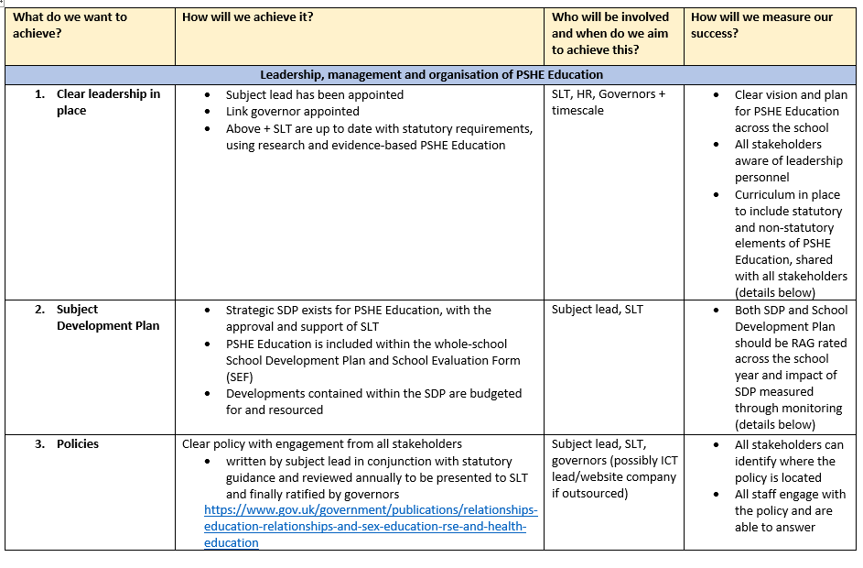
Preparing for the year ahead Subject Development Plan Let’s look at the guidance together

Slide 8
Next Steps: - consider one thing you are going to implement when you get back to school and your main take away from this session - what would you like to look at next?

