Slide 1

Tackling Prejudice & Bullying
• RE now plays a key role in challenging prejudice-motivated bullying (including religion/belief).
• Embed empathy, understanding, and anti-bullying messages into RE.

Slide 2

Participation & Tracking
• Schools must track participation in RE, ensuring SEND and disadvantaged pupils are included.
• Collect evidence and examples for inspection.

Slide 3
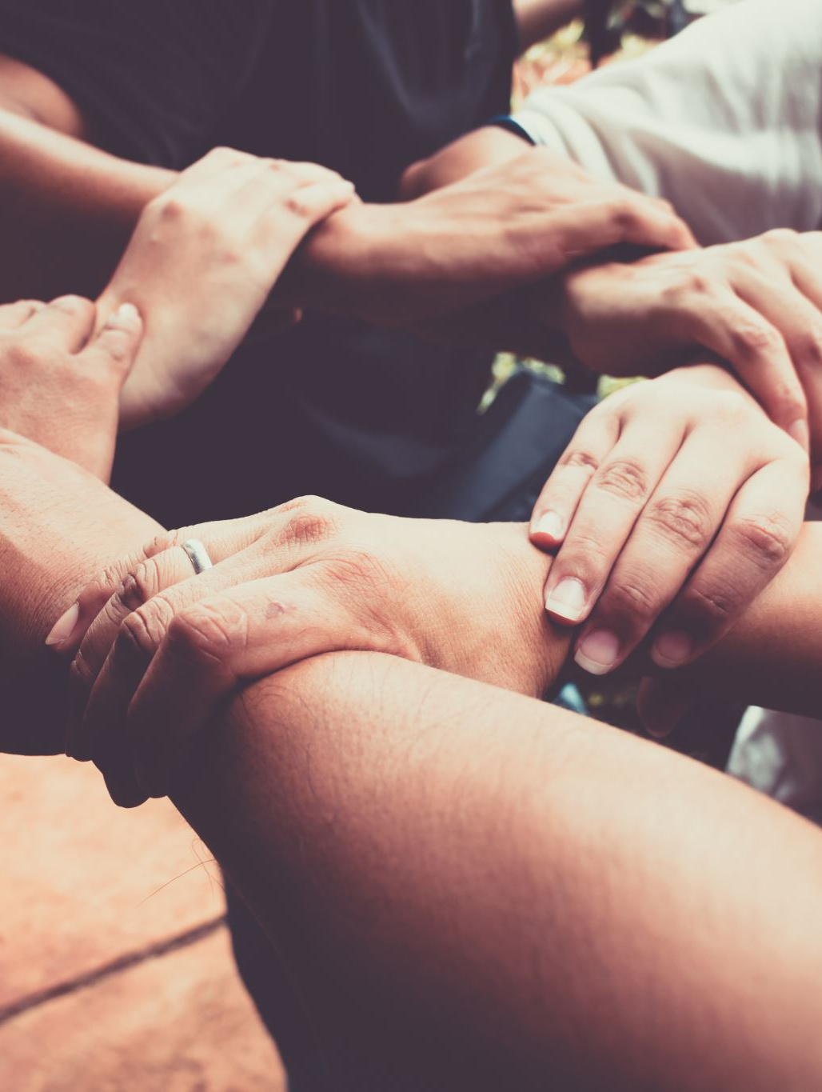
Social & Community Cohesion
• RE helps pupils discuss differences respectfully and celebrate shared values.
• Build partnerships with local faith groups, places of worship, and SACRE.

Slide 4

What Does This Mean for Our Schools?
How visible is RE as an entitlement for all pupils?
What changes might we need to make in monitoring or inclusion?
How does our school demonstrate respect and dialogue through RE?

Slide 5
RE Knowledge Hunt – The Ultimate Quiz Challenge
🎯 Instructions:
• Work in pairs or small groups.
• Use the syllabus overview to find the answers.
• One point for each correct answer – bonus points for the tie-breaker!
Ready to test your knowledge? Let’s begin! 🏆

Slide 6
Knowledge Hunt – Questions 1 to 3
1️⃣ Which enquiry question explores how religious believers show their commitments during the journey of life?
2️⃣ In which unit do pupils learn about how different religions celebrate the birth of a baby?
3️⃣ Which enquiry question focuses on how and why people worship?

Slide 7
Knowledge Hunt – Questions 4 to 6 + Bonus
4️⃣ What question links the natural world with religious teaching about care and responsibility?
5️⃣ Which unit asks why people make vows or commitments to one another?
6️⃣ Find the enquiry question that explores why stories are important and what we can learn from them.
🌟 Bonus Challenge:
Identify two units that include visits to places of worship. Write the place and the religion for each.

Slide 8
RE Knowledge Hunt – Answers 🏆
1️⃣ What does it mean to be a Christian, Muslim, Sikh, Hindu, Jewish or Buddhist?
➡ Explores how believers live out their commitments.
2️⃣ How do religions welcome new members and mark the birth of a baby?
➡ Compares birth ceremonies such as Baptism, Aqiqah, and Hindu naming rites.
3️⃣ How and why do people worship?
➡ Looks at prayer, rituals, and reasons for worship across faiths.
4️⃣ What do religions teach us about the natural world and why should we care for it?
➡ Explores creation stories and stewardship.
5️⃣ Why do people make vows or commitments to one another?
➡ Examines marriage, promises, and community responsibility.
6️⃣ Why are stories important and what do they teach us?
➡ Considers moral lessons and inspiration from religious stories.
🌟 Bonus Challenge:
➡ Examples: Church (Christianity), Mosque (Islam), Mandir (Hinduism), Synagogue (Judaism), Gurdwara (Sikhism).

Slide 9
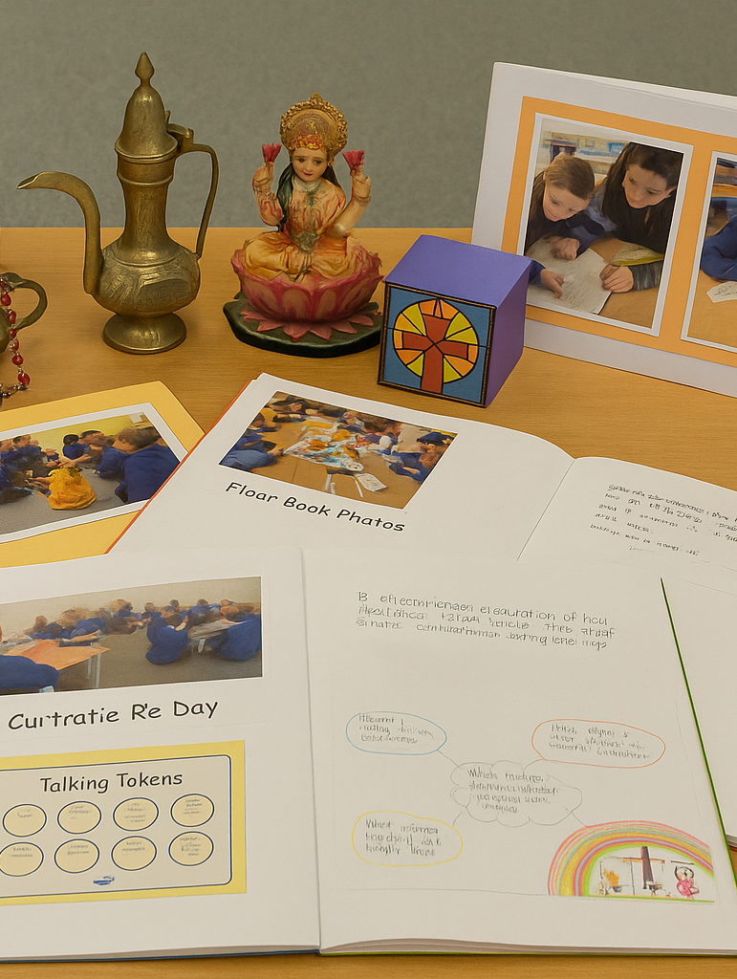
Marketplace: Sharing Creative RE Practice
Display your school’s artefacts, floor book photos, pupil voice examples, or creative RE day ideas.

Slide 10

Leadership Passport
Reflect and record in your RE Leadership Passport:
• My short-term goal (by Christmas)
• My long-term goal (by July)
• One thing I will share with colleagues

Slide 11

Wrap-Up: One Word Wall
Reflection: Write one word that sums up today and place it on the board.
Discuss: 'What will you take back to school tomorrow?'
Next Meeting Focus: Resources
Contact: sassenjee@mayespark.Redbridge.sch.uk

