Slide 1


Onboarding your new ECTs and Mentors for September 2026
Thursday 25th June, 3.45 to 4.45pm

Slide 2

Bob Drew – director of UCL programmes for REP
This session will be recorded and distributed later to absent colleagues
Please ask questions – raise hands or wait to the end

Slide 3
Timeline for appointments
School appoints ECT
Gather information on the ECT
Confirm your Induction Tutor details
Appoint a mentor
Confirm your choice of Appropriate Body

Slide 4
“Register Early Career Teachers”
www.register-early-career-teachers.education.gov.uk
Live on 15th June
Walk-through of updates available on the REP website: https://www.redbridgeeducationpartnership.co.uk/early-career-teacher-entitlement/
Induction Tutor will input the information
Collect all relevant data before beginning
The upload process is streamlined to align with your school’s previous Delivery Partner history. If you have already worked with REP, this information on programme choices will be pre-populated.

Slide 5
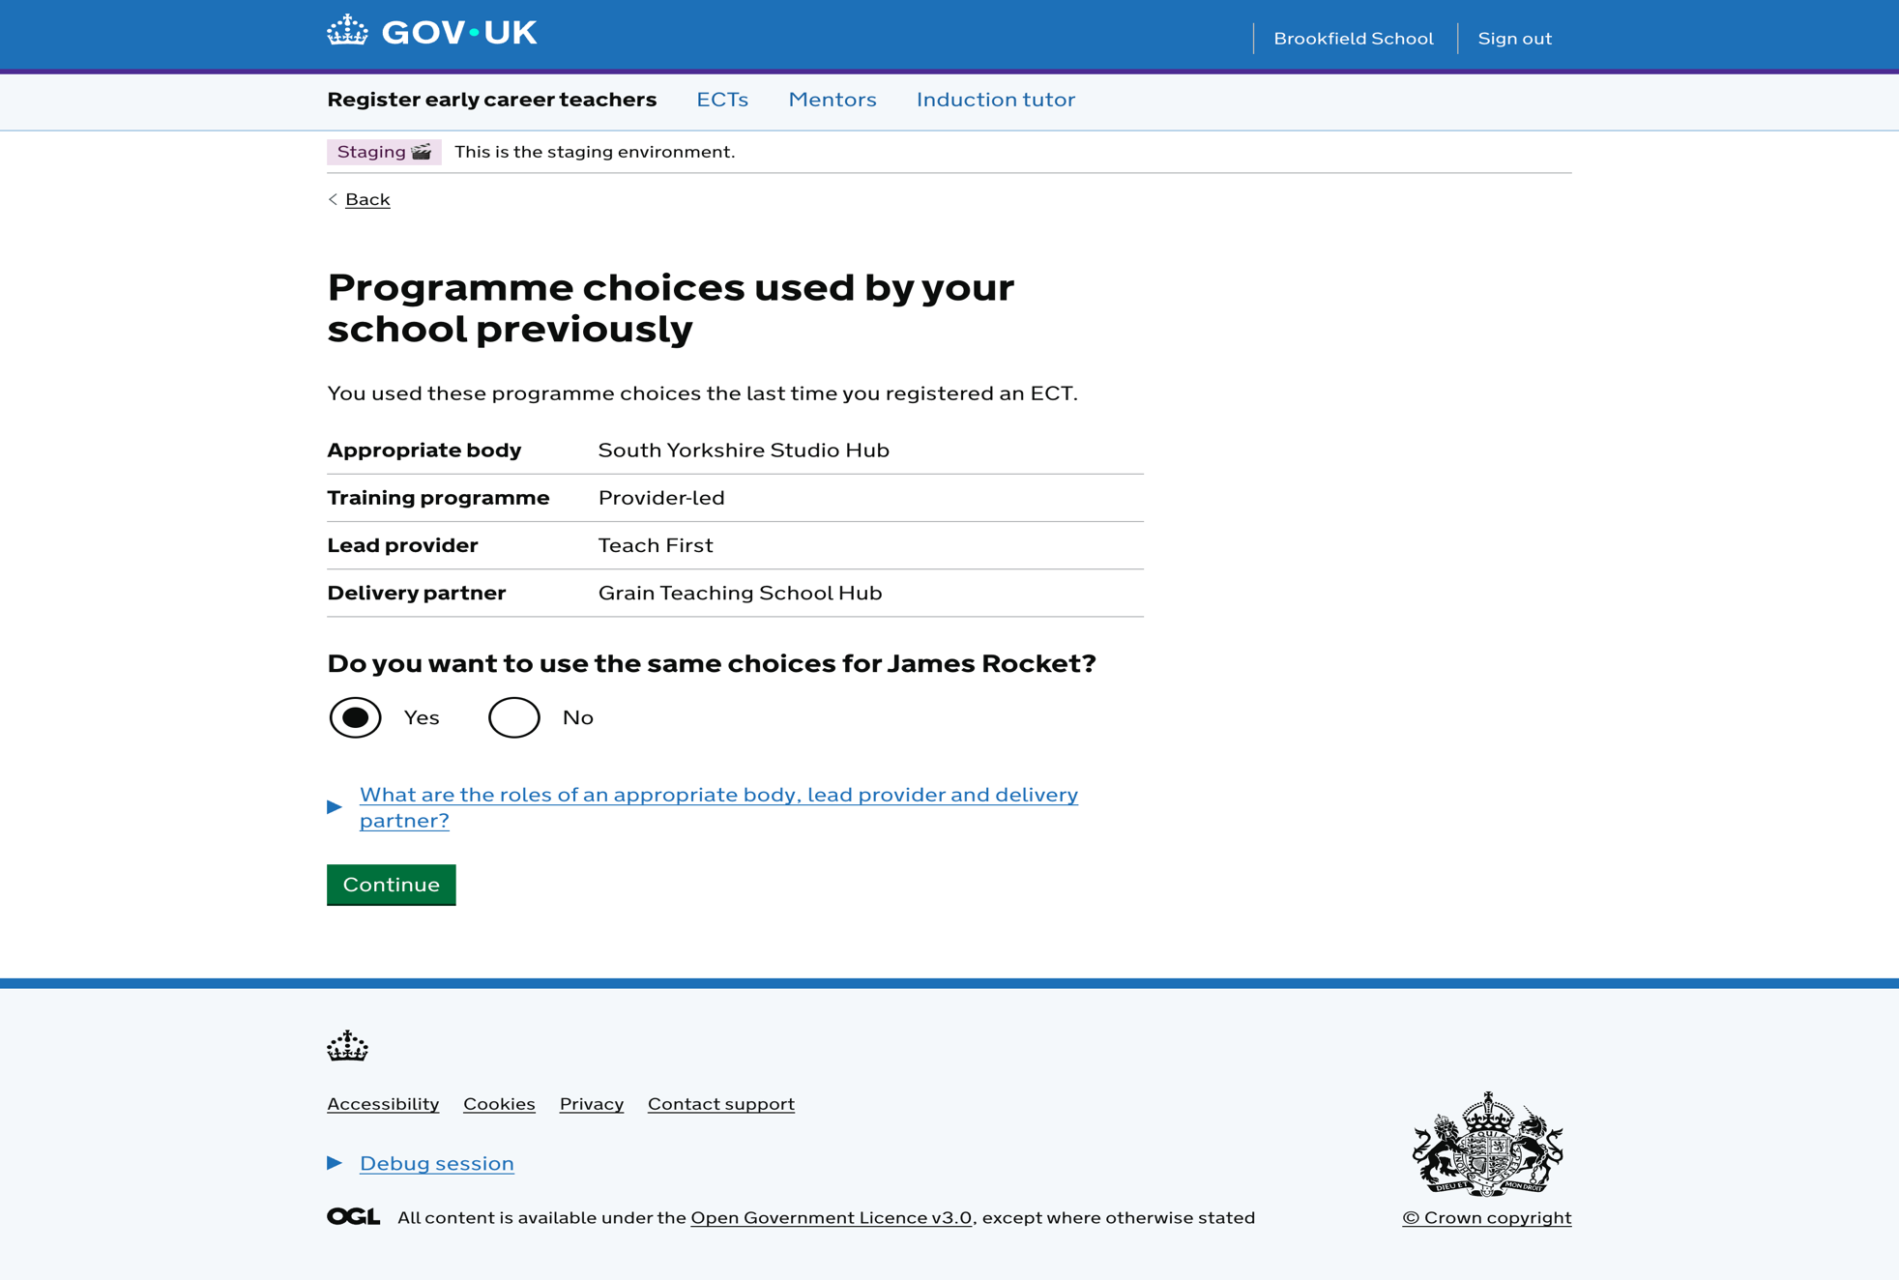

Slide 6
Information to upload onto the website
ECT – starting date and TRN
Appropriate Body – local choices
Training programme – Provider-led
Your Lead Provider – UCL
Yor Delivery Partner – Redbridge Education Partnership
Important to get this information correct at this point

Slide 7
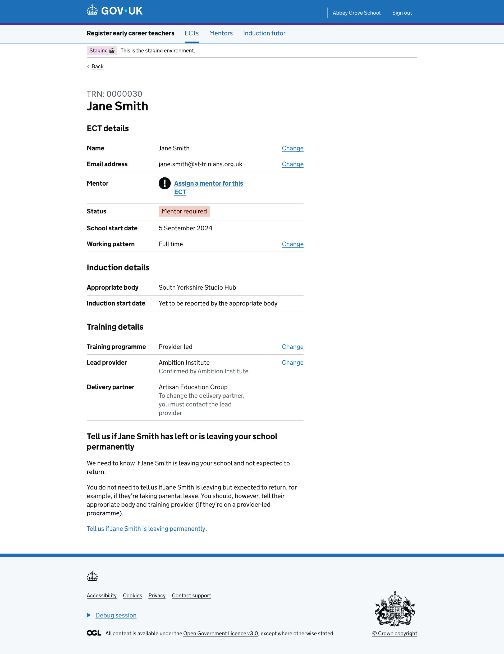

Slide 8
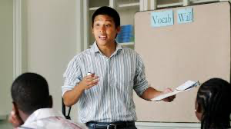
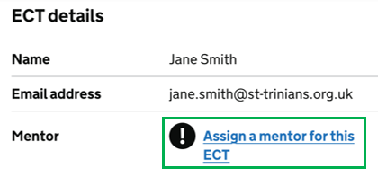
Mentor registration
Assign a mentor to each ECT

Slide 9
Contact REP – “Expression of Interest” form
Link - details on REP website:
https://docs.google.com/forms/d/e/1FAIpQLSfcGXB9yRgUGJ-0U1qKFZ8hlzUGdUVCS7k2ryu-kWlcHeTtFA/viewform?usp=header
Very important stage, apologies for having to ask you to repeat the uploading of information.

Slide 10

ECT Manager
Confirm details with your AB

Slide 11
REP’s next steps
We will contact each ECT and mentor, as well as the Induction Tutor:
  Induction events
  Training schedule
  Dates and times
  Venues
  Confirm UCL Extend access
  Advice on pre-course engagement activities

Slide 12
The ECTE programme
Detail on REP website
Two-year programme
In-person and online training sessions
UCL refinements now complete
Non-contact entitlement
Keys to success for the school to support the ECT
Attending training
Cohorts
Venues
UCL Extend account

Slide 13
Mentor training
For those with previous mentor training with UCL?
New mentors:
One year programme
One day induction meeting in September
2 online repeat sessions - refreshers
Self-study
Weekly meetings with ECT

Slide 14

Questions

